Slide 1
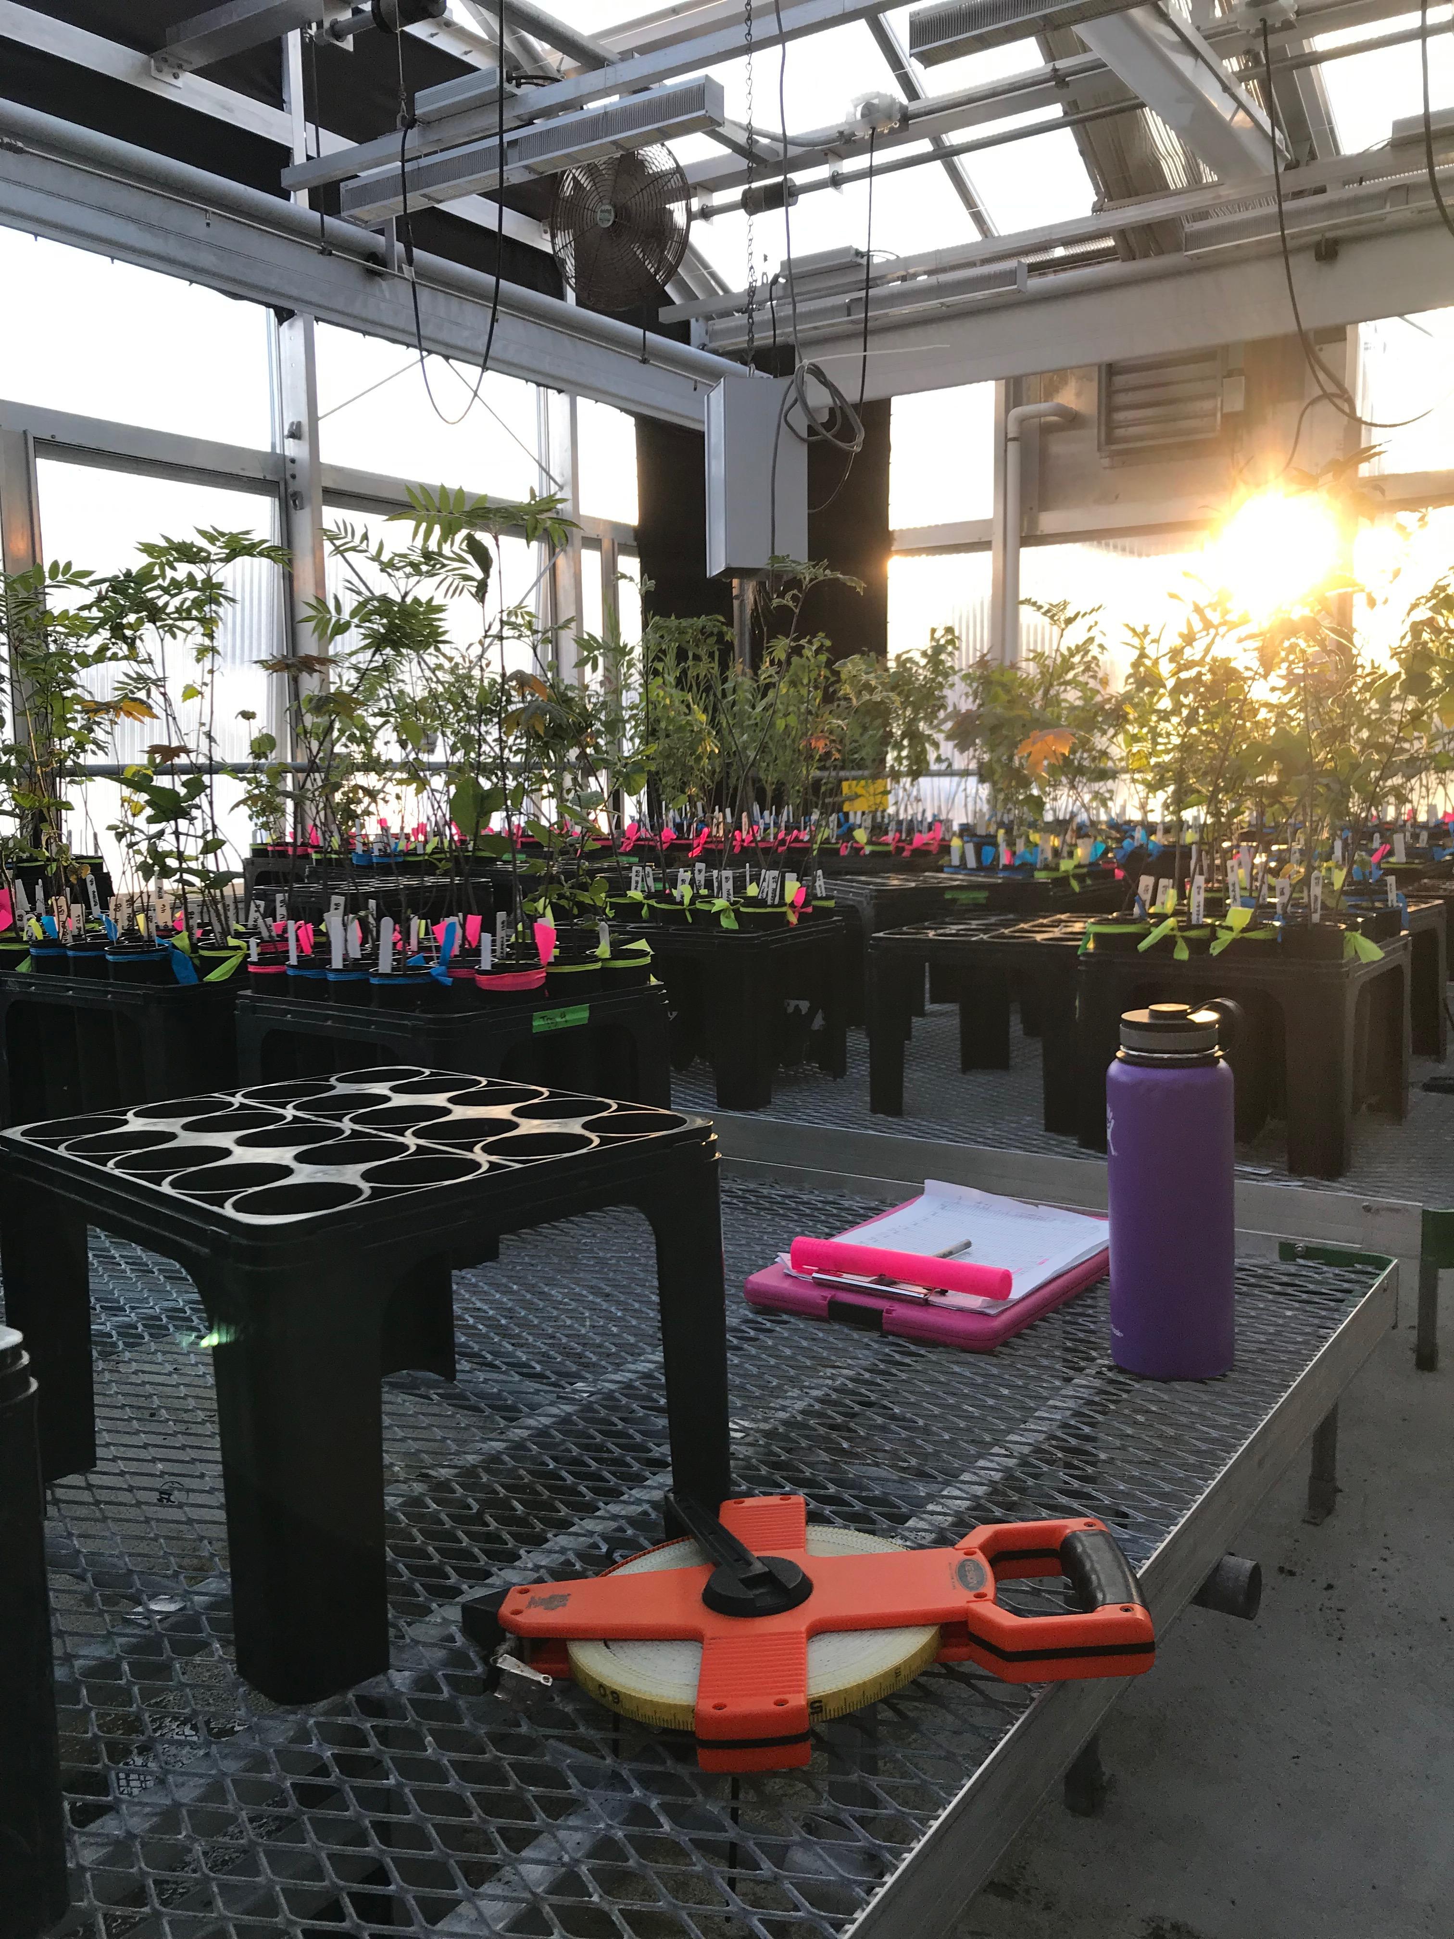
False springs in a warming world

Slide 2
Frost tolerance
Duration of Vegetative Risk

Slide 3
Species differences: tolerance vs avoidance

Slide 4
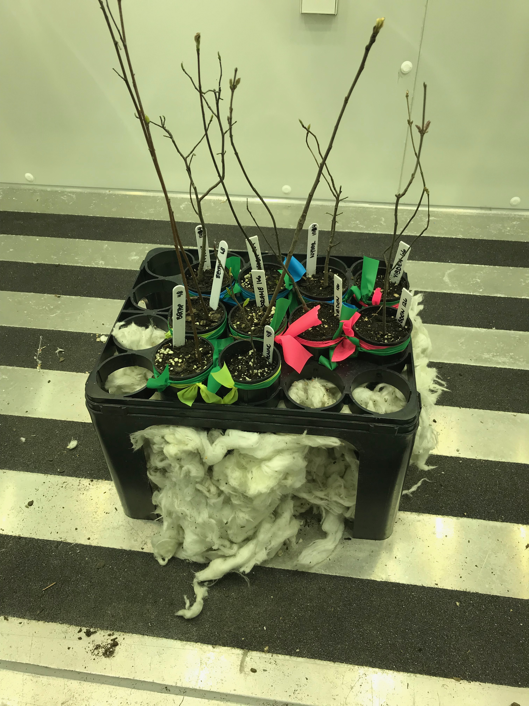
10 SPECIES
3 LEVELS OF CHILLING (4℃)
4 weeks
6 weeks
8 weeks
FALSE SPRING

Slide 5
How bad are false springs?
Phenology:
Observe budburst to leafout
Observe maybe flowers?
Budset, leaf color and leaf drop
Growth:
Height at leafout
Height before budset (2 months past leafout)
Height after budset
Chlorophyll content (same times as above minus at leafout)
Below and aboveground biomass
Potential other measurements:
Secondary compounds or pH – herbivory
Amino acids – proline, glutamine

Slide 7
DVR by Day of BB

Slide 8
Height and Chl: 60 days after leafout

Slide 10
Questions:
When do I increase the photoperiod and/or temperature?
Any other measurements?
Thoughts on secondary compounds/pH
Raised beds and monitor DVR next year?
rstan vs rstanarm vs brms

Slide 11
